Slide 1

Web Project for Exchange Student
SKKUEXS
김주원 | 서현원 | 이하은 | 한희근

Slide 2

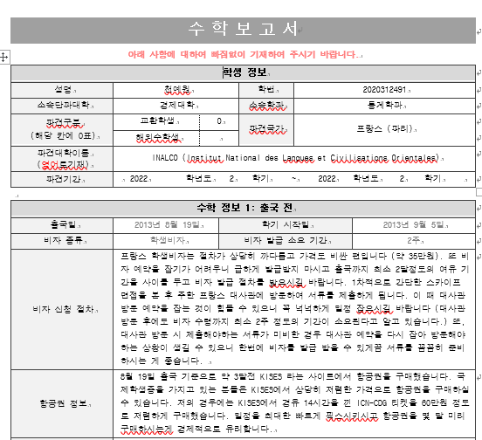
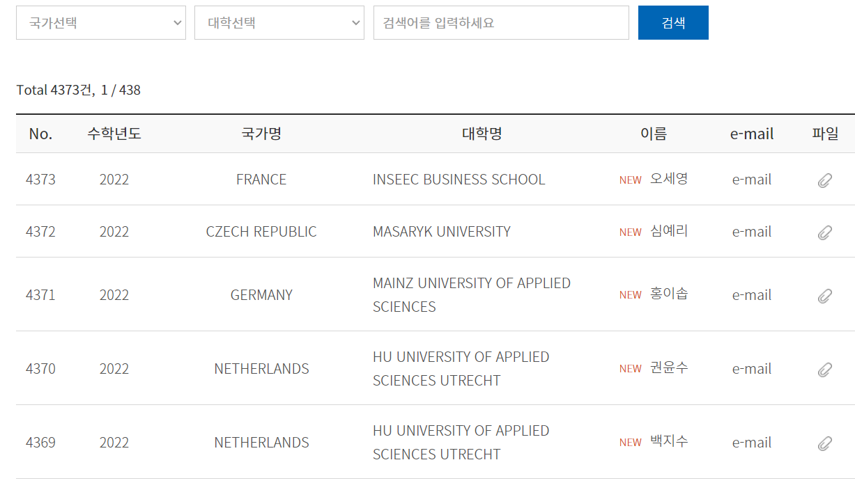
Problem
1. Functional inconvenience of SKKU learning report website
2

Slide 3
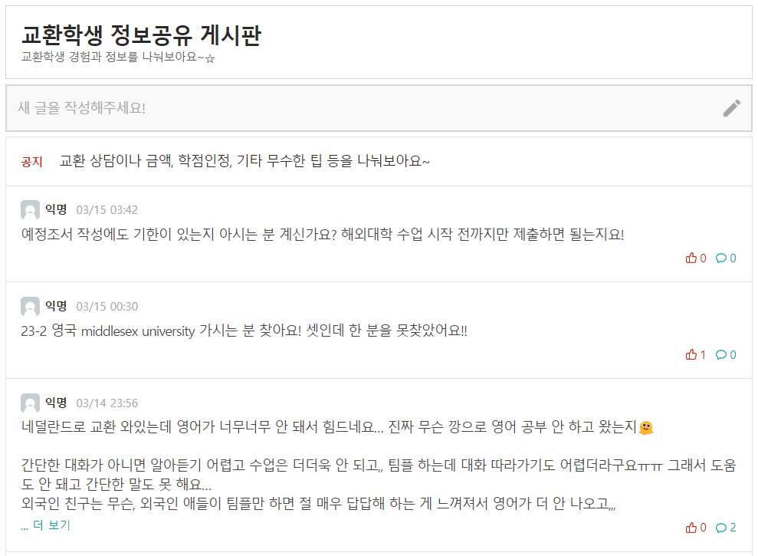
Problem
2. Lack of community for exchange student
3

Slide 4
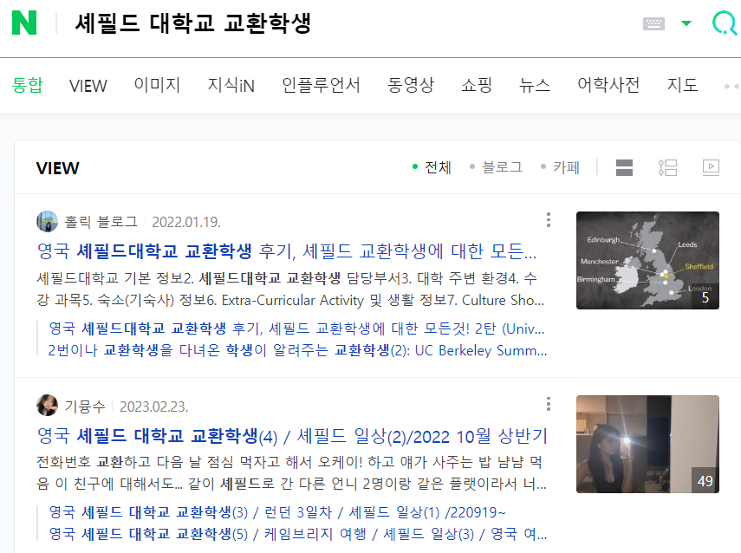
Problem
3. Difficulty in finding a ‘right/proper’ information
4

Slide 5

Problem & Needs
Q. Where did you get help for preparing living abroad?
Many students feel burden and difficulties in preparation for exchange student program
But, there’s no active support for them
Other Uni Students
17%
72%
By myself
There is demand of connecting with previous program participants or local alumnus students through mentoring or community
많은 학생들은 해외 수학 프로그램이 선발된 이후의 모든 준비와 절차를 대학의 도움 없이 학생 혼자 진행하여야 한다는 부담감과 어려움을 느끼는 것으로 파악되었다.
- `19 고려대학교 교육대학원, 강미리

Slide 6
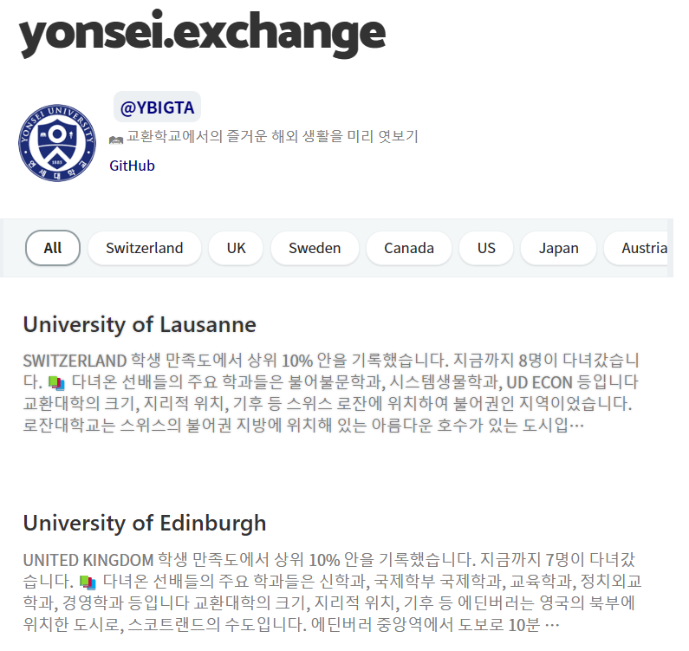
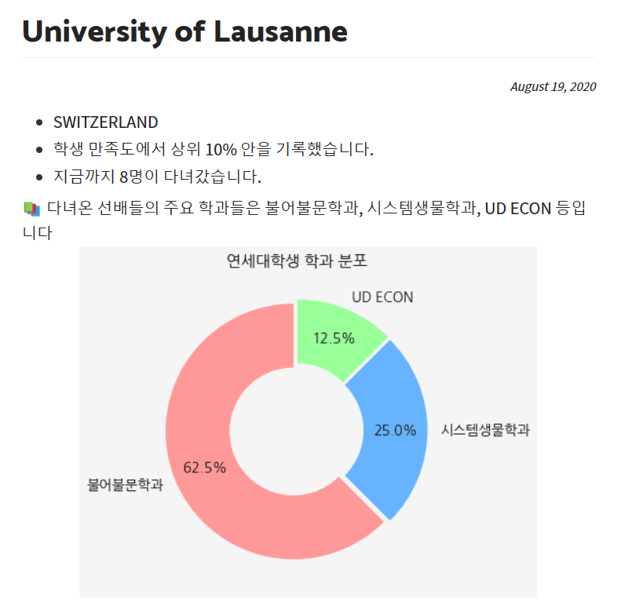
Solution - Idea
1. Provide information of university– yonsei-exchange.netlify.app
6

Slide 7
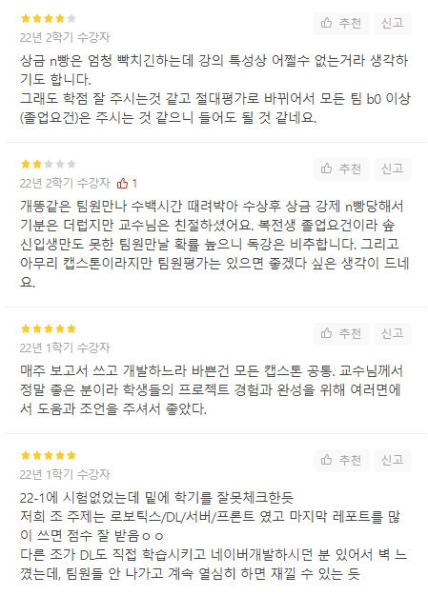
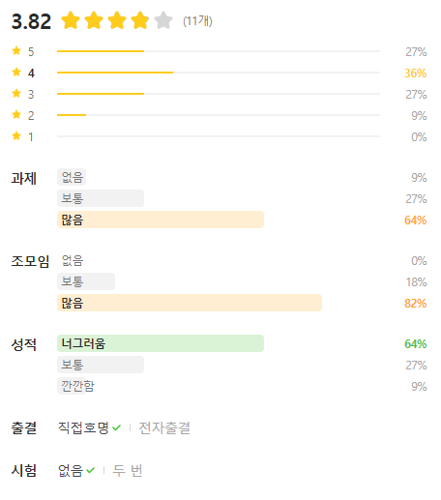
Solution - Idea
2. Provide overall rating system
7

Slide 8
SKKUEXS VISION
Final Goal
A to Z for students
Secondary Goal
Community service
Primary Goal
Analysis of report
Helping students to preparing,
dispatching, and returning.
Web community for
Exchange students
✔ Service
✔ Method
✔ Target
Provide summary and analysis
Of SKKU learning report
Connect students with external
Commercial enterprises
Develop web service with
Django & Flask
Summarize the report with
Natural language process
All of the Korean
university student
All of the Korean
university student
SKKU student
SKKUEXS
[
]
Create a tool to support the exchange student system
8

Slide 9
Competitiveness
SKKUEXS
= Yonsei-Exchange + Everytime + α
SKKUEXS
Yonsei-Exchange
Everytime
How information
Is provided
Assessment analysis and provision
Assessment analysis and provision
X
User of service
All the Korean university students
Yonsei university students
Each university student
Goal of service
Community for exchange students
Analysis information of
Partner university
Free communication board
Information provided
by each university and community
for exchange students
Easy to search
partner university information
Characteristic
Free real-time communication
9

Slide 10

Functions
1. Categorize country and university
University of Leeds
IESED
Singapore Management University
Sabanci University
10

Slide 11
Functions
2. Summarize objective information ; Visa, dormitory, resister courses etc.
에딘버러 대학의 캠퍼스는 시내 곳곳에 캠퍼스가 위치해 있습니다.
캠퍼스가 시내 중심부에 주로 위치해 있기 때문에 주변에 식당가가 많이 있습니다.
학교 캠퍼스 주변에는 관광객이 많이 다니는 royal mile 정도가 있지만 에딘버러 기차역을 지나면 princes street라는 최대 번화가가 나옵니다.
솔직히 대학이 시내에 위치하다 보니 놀거리는 매우 많습니다.
11

Slide 12
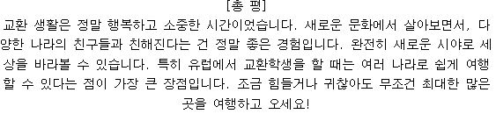

Functions
3. Summarize subjective information ; Impression/thought/review
Overall rating
교환을 갔다오기 전 저에게 스위스는 그다지 친근하지 않은 나라였지만, 로잔대학교에서의 한학기는 스위스, 나라 자체에 애정이 생기게 할만큼 정말 행복했습니다.
혼자 계속 다니면 너무 할 게 없으니 스위스 친구든 교환학생 친구든 다가가서 친해지면 학기를 재미있게 보내는 데에 도움이 될 것 같습니다.
로잔에서의 생활은 완벽했습니다.
한국의 바쁜 일상에서도 로잔의 한 학기 생각을 하면 마음이 평화로워진다.
많은 나라를 여행다니기보다 한 곳에서 생활해보는 것이 목표였던 내게 스위스 로잔은 좋은 선택이었던 것 같다.
12

Slide 13
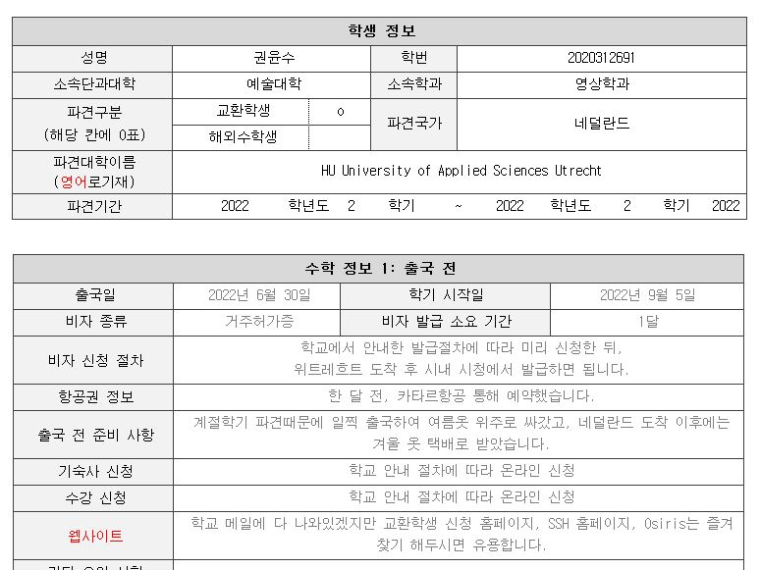
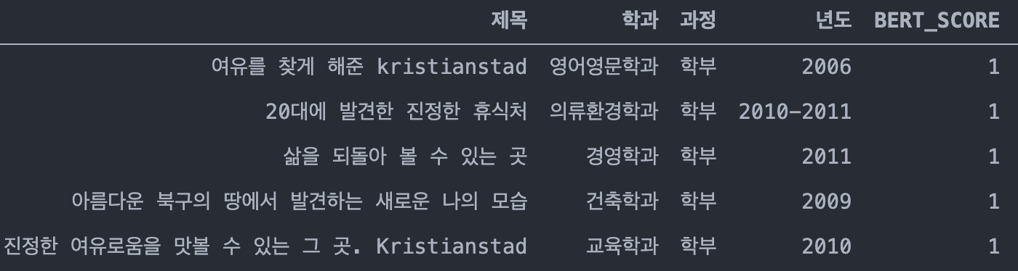
Functions
Raw Data
Python – Requests, BeautifulSoup, Selenium
Data Collection
.docx File → Python docx Library
.hwp File → win32com.client Module
13

Slide 14
Functions
4. Visualize satisfaction of exchange program and keywords of each university
satisfaction score 84%
14

Slide 15
Project Planning
To – do Week | 3 | 4 | 5 | 6 | 7 | 8 | 9 | 10 | 11 | 12 | 13
Proposal & Study
Data Collecting
Data Processing (NLP)
Front-end (Planning & UI/UX)
Back-end (Server & DB Design)
Beta Test
15

Slide 16
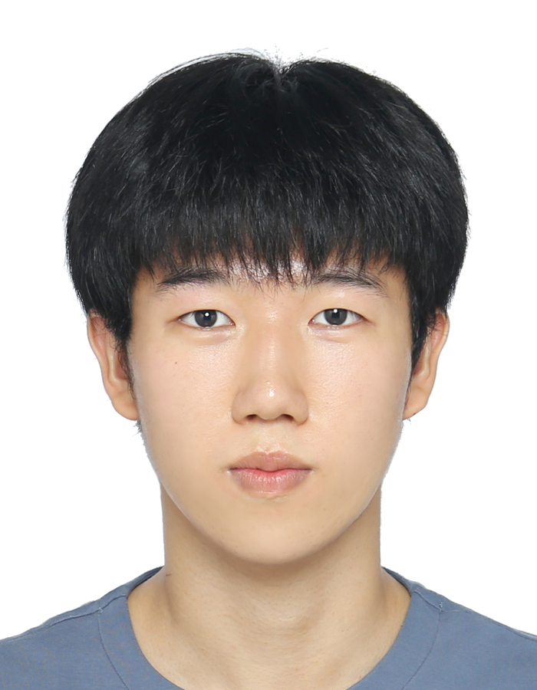
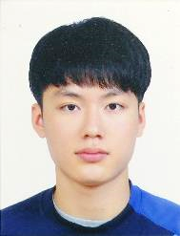
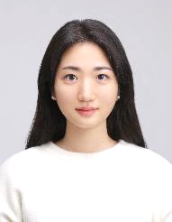
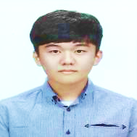
Team Composition & Ability
Juwon Kim
Web Crawling
Server & DB Design
Hyunwon Seo
Data Processing
Server & DB Design
Haeun Lee
Data Process(NLP)
Planning/Designing
Huigeun Han
Data Collecting
UI/UX Design
16

Slide 17
Reference
SKKU learning report
https://www.skku.edu/skku/international/globalComm/international_list03.do
Yonsei exchange
https://yonsei-exchange.netlify.app/
Everytime exchange student information sharing
https://everytime.kr/386599
Python-docx
https://python-docx.readthedocs.io/en/latest
Win32com
https://wikidocs.net/153174
A Study on the Experience of Students Participating in the Exchange Student Program: A case study of University A
https://dcollection.korea.ac.kr/public_resource/pdf/000000083942_20230315092420.pdf
17

Slide 18
Q&A
제대로 적용된 디자인은 우리 삶의 질을 높이고,
직업을 만들어 내며 사람을 행복하게 만든다. by 폴 스미스

